Slide 1

Chapter 11
Chi-Square Tests

Slide 2
Objectives
In this chapter, you learn:
How and when to use the chi-square test for contingency tables

Slide 3
Contingency Tables
DCOVA
Contingency Tables
Useful in situations comparing multiple population proportions
Used to classify sample observations according to two or more characteristics
Also called a cross-classification table.

Slide 4
Contingency Table Example
DCOVA
Left-Handed vs. Gender
Dominant Hand: Left vs. Right
Gender: Male vs. Female
2 categories for each variable, so this is called a 2 x 2 table
Suppose we examine a sample of
300 children

Slide 5
Contingency Table Example
(continued)
DCOVA
Sample results organized in a contingency table:
Gender | Hand Preference
 | Left | Right
Female | 12 | 108 | 120
Male | 24 | 156 | 180
 | 36 | 264 | 300
sample size = n = 300:
120 Females, 12 were left handed
180 Males, 24 were left handed

Slide 6
χ² Test for the Difference Between Two Proportions
DCOVA
H₀: π₁ = π₂ (Proportion of females who are left
handed is equal to the proportion of
males who are left handed)
H₁: π₁ ≠ π₂ (The two proportions are not the same)
If H₀ is true, then the proportion of left-handed females should be the same as the proportion of left-handed males
The two proportions above should be the same as the proportion of left-handed people overall

Slide 7
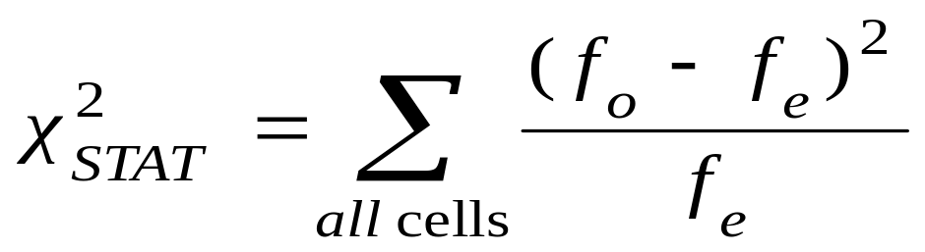
The Chi-Square Test Statistic
DCOVA
The Chi-square test statistic is:
where:
f_{o} = observed frequency in a particular cell
f_{e} = expected frequency in a particular cell if H₀ is true
(Assumed: each cell in the contingency table has expected
frequency of at least 5)

Slide 8
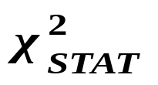
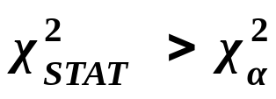
Decision Rule
DCOVA
The test statistic approximately follows a chi-squared distribution with one degree of freedom
Decision Rule:
If , reject H₀, otherwise, do not reject H₀
α
0
χ²
Do not
reject H₀
Reject H₀
χ²_{α}

Slide 9
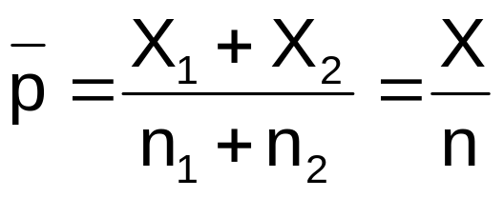
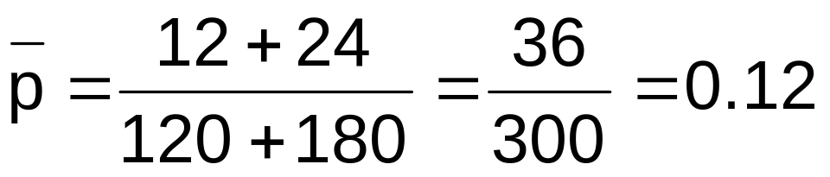
Computing the
Overall Proportion
DCOVA
The overall proportion is:
120 Females, 12 were left handed
180 Males, 24 were left handed
Here:
i.e., based on all 300 children the proportion of left handers is 0.12, that is, 12%

Slide 10
Finding Expected Frequencies
DCOVA
To obtain the expected frequency for left handed females, multiply the average proportion left handed (p) by the total number of females
To obtain the expected frequency for left handed males, multiply the average proportion left handed (p) by the total number of males
If the two proportions are equal, then
P(Left Handed | Female) = P(Left Handed | Male) = .12
i.e., we would expect (.12)(120) = 14.4 females to be left handed
(.12)(180) = 21.6 males to be left handed

Slide 11
Observed vs. Expected Frequencies
DCOVA
Gender | Hand Preference
 | Left | Right
Female | Observed = 12 Expected = 14.4 | Observed = 108 Expected = 105.6 | 120
Male | Observed = 24 Expected = 21.6 | Observed = 156 Expected = 158.4 | 180
 | 36 | 264 | 300

Slide 12
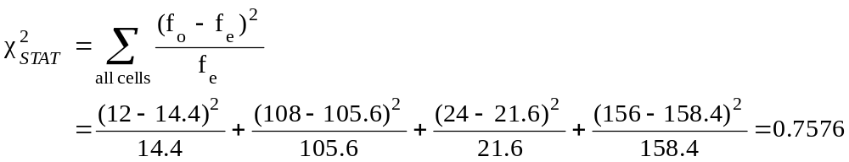
The Chi-Square Test Statistic
DCOVA
Gender | Hand Preference
 | Left | Right
Female | Observed = 12 Expected = 14.4 | Observed = 108 Expected = 105.6 | 120
Male | Observed = 24 Expected = 21.6 | Observed = 156 Expected = 158.4 | 180
 | 36 | 264 | 300
The test statistic is:

Slide 13
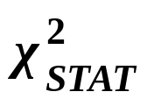
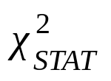
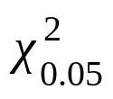
Decision Rule
DCOVA
Decision Rule:
If > 3.841, reject H₀, otherwise, do not reject H₀
Here,
= 0.7576< = 3.841,
so we do not reject H₀ and conclude that there is not sufficient evidence that the two proportions are different at α = 0.05
0.05
0
χ²
Do not
reject H₀
Reject H₀
χ²_{0.05} = 3.841

Slide 14
χ² Test for Differences Among
More Than Two Proportions
DCOVA
Extend the χ² test to the case with more than two independent populations:
H₀: π₁ = π₂ = … = π_{c}
H₁: Not all of the π_{j} are equal (j = 1, 2, …, c)

Slide 15
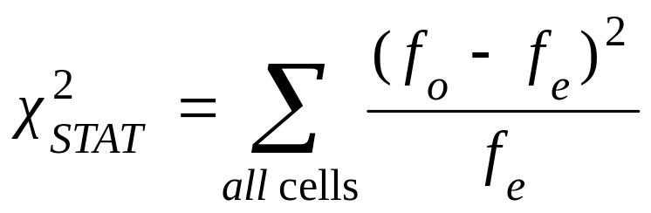
The Chi-Square Test Statistic
DCOVA
The Chi-square test statistic is:
Where:
f_{o} = observed frequency in a particular cell of the 2 x c table
f_{e} = expected frequency in a particular cell if H₀ is true
(Assumed: each cell in the contingency table has expected
frequency of at least 1)

Slide 16
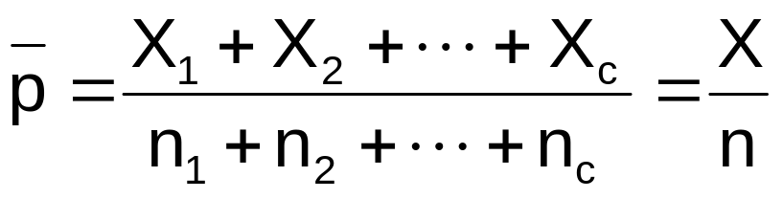

Computing the
Overall Proportion
DCOVA
The overall proportion is:
Expected cell frequencies for the c categories are calculated as in the 2 x 2 case, and the decision rule is the same:
Where is from the chi-squared distribution with c – 1 degrees of freedom
Decision Rule:
If , reject H₀, otherwise, do not reject H₀

Slide 17
χ² Test of Independence
DCOVA
Similar to the χ² test for equality of more than two proportions, but extends the concept to contingency tables with r rows and c columns
H₀: The two categorical variables are independent
(i.e., there is no relationship between them)
H₁: The two categorical variables are dependent
(i.e., there is a relationship between them)

Slide 18

χ² Test of Independence
(continued)
The Chi-square test statistic is:
DCOVA
where:
f_{o} = observed frequency in a particular cell of the r x c table
f_{e} = expected frequency in a particular cell if H₀ is true
(Assumed: each cell in the contingency table has expected
frequency of at least 1)

Slide 19
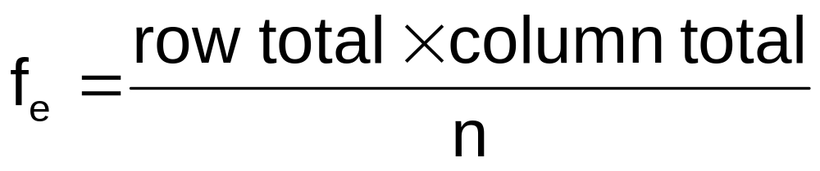
Expected Cell Frequencies
DCOVA
Expected cell frequencies:
Where:
row total = sum of all frequencies in the row
column total = sum of all frequencies in the column
n = overall sample size

Slide 20
Decision Rule
DCOVA
The decision rule is
If , reject H₀,
otherwise, do not reject H₀
Where is from the chi-square distribution with (r – 1) (c – 1) degrees of freedom

Slide 21
Example
DCOVA
The meal plan selected by 200 students is shown below:
Class Standing | Number of meals per week |  |  | Total
 | 20/week | 10/week | none
Fresh. | 24 | 32 | 14 | 70
Soph. | 22 | 26 | 12 | 60
Junior | 10 | 14 | 6 | 30
Senior | 14 | 16 | 10 | 40
Total | 70 | 88 | 42 | 200

Slide 22
Example
DCOVA
(continued)
The hypothesis to be tested is:
H₀: Meal plan and class standing are independent
(i.e., there is no relationship between them)
H₁: Meal plan and class standing are dependent
(i.e., there is a relationship between them)

Slide 23
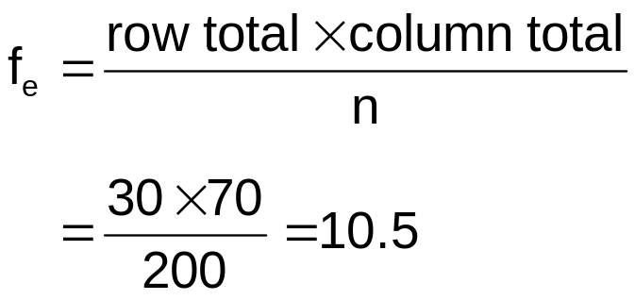
Example:
Expected Cell Frequencies
(continued)
Observed:
DCOVA
Class Standing | Number of meals per week |  |  | Total
 | 20/wk | 10/wk | none
Fresh. | 24 | 32 | 14 | 70
Soph. | 22 | 26 | 12 | 60
Junior | 10 | 14 | 6 | 30
Senior | 14 | 16 | 10 | 40
Total | 70 | 88 | 42 | 200
Expected cell frequencies if H₀ is true:
Class Standing | Number of meals per week |  |  | Total
 | 20/wk | 10/wk | none
Fresh. | 24.5 | 30.8 | 14.7 | 70
Soph. | 21.0 | 26.4 | 12.6 | 60
Junior | 10.5 | 13.2 | 6.3 | 30
Senior | 14.0 | 17.6 | 8.4 | 40
Total | 70 | 88 | 42 | 200
Example for one cell:

Slide 24
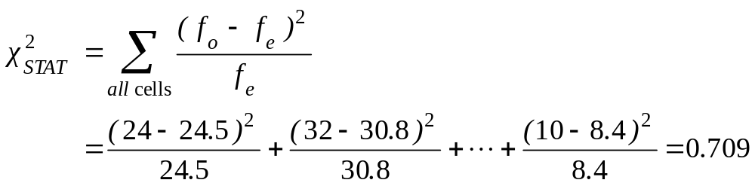
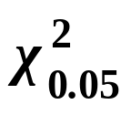
Example: The Test Statistic
(continued)
DCOVA
The test statistic value is:
= 12.592 from the chi-square distribution with (4 – 1)(3 – 1) = 6 degrees of freedom

Slide 25

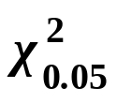
Example:
Decision and Interpretation
DCOVA
(continued)
Decision Rule:
If > 12.592, reject H₀, otherwise, do not reject H₀
0.05
Here,
= 0.709 < = 12.592,
so do not reject H₀
Conclusion: there is not sufficient evidence that meal plan and class standing are related at α = 0.05
0
χ²
Do not
reject H₀
Reject H₀
χ²_{0.05}=12.592

Slide 26
Chapter Summary
In this chapter we discussed:
How and when to use the chi-square test for contingency tables

